Slide 1
CS5112: Algorithms and Data Structures for Applications
Locality-sensitive Hashing
Ramin Zabih
Some content from: Wikipedia; Charles Kingsford

Slide 2
Administrivia
A duck problem will be on the final exam
But lower bounds will not be, since it’s not core
Extra office hours the week of December 1
Final exam will be split among 2-3 nearby rooms
Students will be assigned to a room to avoid crowding

Slide 3
Lecture outline
Chord and skiplists
MinHash
Locality sensitive hashing

Slide 4
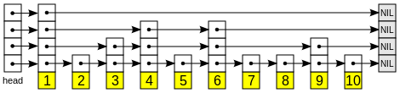
Skip lists
Can we find an element in a sorted list quickly?
Hierarchy of ‘express lanes’, randomly generated
Insertion at bottom level, promote a level ½ the time
No need for complex rebalancing schemes
Source

Slide 5
Best skiplist slide (from Kingsford)
Source

Slide 6
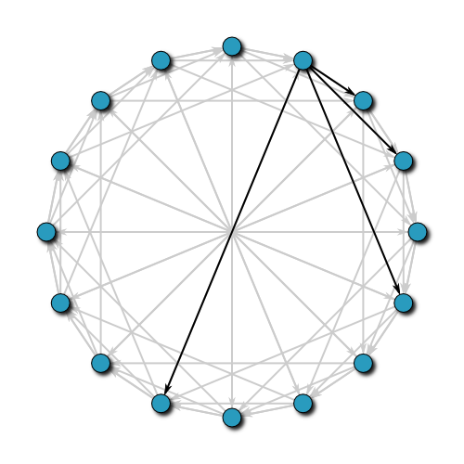
Chord: using local knowledge
Can we do this without global information?
Each node keeps a “finger table”
Like a skip list but circular
Can efficiently find the right node
Good ways of handling new nodes
Update finger tables in the background
No great ideas on handling crashes
Source

Slide 7
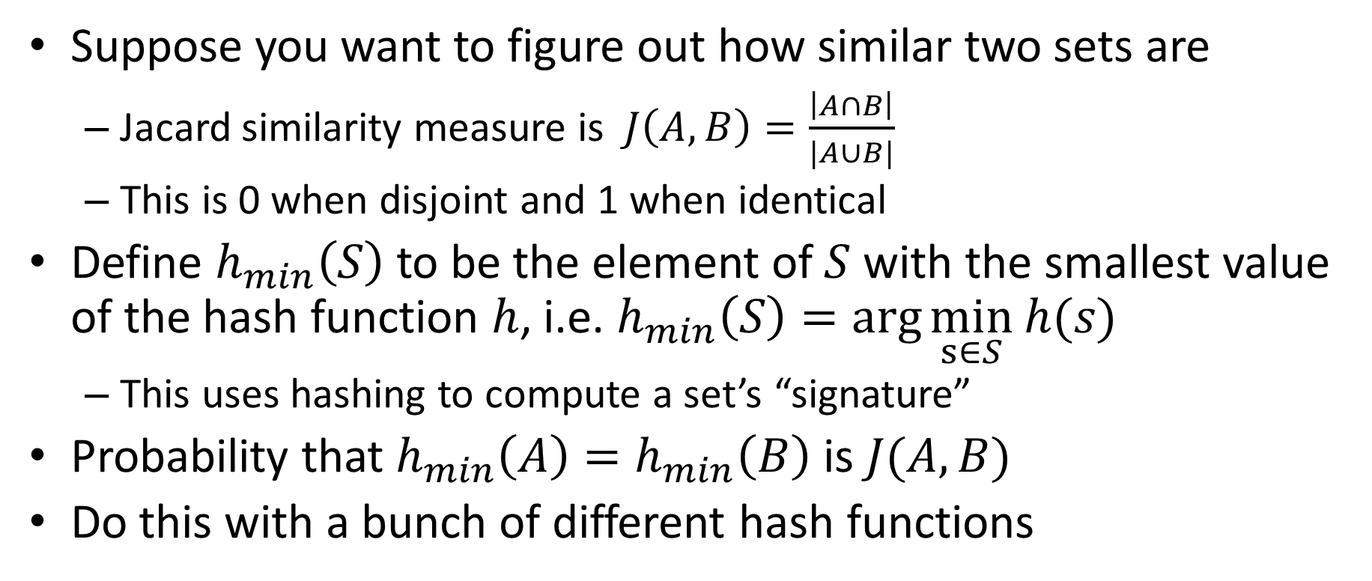
MinHash
Suppose you want to figure out how similar two sets are
Jacard similarity measure is $J\left(A,B\right)=\frac{\left|A∩B\right|}{|A∪B|}$
This is 0 when disjoint and 1 when identical
Define $h_{min}\left(S\right)$ to be the element of $S$ with the smallest value of the hash function $h$, i.e. $h_{min}\left(S\right)=\arg{\min_{s∈S}}$ $h(s)$
This uses hashing to compute a set’s “signature”
Probability that $h_{min}\left(A\right)=h_{min}\left(B\right)$ is $J(A,B)$
Do this with a bunch of different hash functions
Notes:
Proof idea: P(min A = min B) = P(min{A \union B} \in A \intersect B) = J(A,B)
Direction is obvious
<= Direction from contrapositive

Slide 8
MinHash applications
Copying detection from articles
Collaborative filtering!
Amazon, NetFlix, etc.

Slide 9
Curse of dimensionality
High dimensions are not intuitive, and data becomes sparse
Volume goes up so fast that an exponential amount of data needed
“Most of the volume is in the corners” theorem
Think of a 3D sphere inscribed in a box
Particularly problematic for NN search
k-d trees requires exponential time

Slide 10
Approximate NN via hashing
Normally collisions make a hash function bad
In this application, certain collisions are good!
Main idea: hash the data points so that nearby items end up in the same bucket
At query time, hash the query and check the bucket elements
Most famous technique is Locality Sensitive Hashing (LSH)

Slide 11
Locality sensitive hashing
We can use hashing to solve ‘near neighbors’
And thus nearest neighbors, if we really need this
Ensuring collisions is the key idea!
Make nearby points hash to the same bucket
In a probabilistic manner
By giving up on exactness we can overcome the curse of dimensionality
This is an extremely important technique in practice

Slide 12
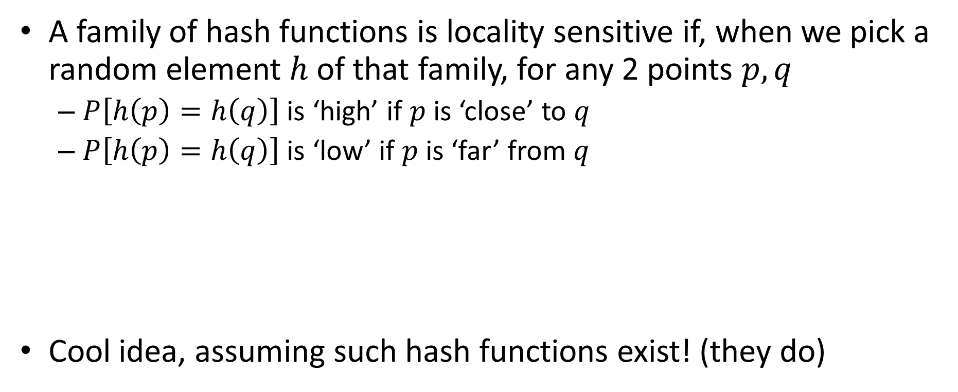
Basic idea of LSH
A family of hash functions is locality sensitive if, when we pick a random element $h$of that family, for any 2 points $p,q$
$P\left[h\left(p\right)=h\left(q\right)\right]$ is ‘high’ if $p$ is ‘close’ to $q$
$P\left[h\left(p\right)=h\left(q\right)\right]$ is ‘low’ if $p$ is ‘far’ from $q$
Cool idea, assuming such hash functions exist! (they do)

Slide 13
Visualizing LSH
q
p

Slide 14
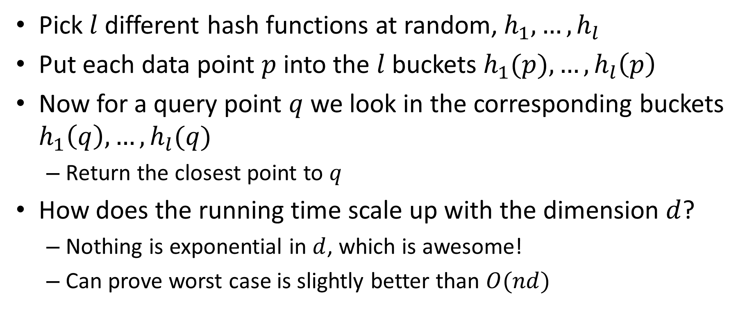
How to use LSH for NN
Pick $l$ different hash functions at random, $h_{1},…, h_{l}$
Put each data point $p$into the $l$buckets $h_{1}(p), …, h_{l}\left(p\right)$
Now for a query point $q$ we look in the corresponding buckets $h_{1}\left(q\right), …, h_{l}(q)$
Return the closest point to $q$
How does the running time scale up with the dimension $d$?
Nothing is exponential in $d$, which is awesome!
Can prove worst case is slightly better than $O(nd)$

Slide 15
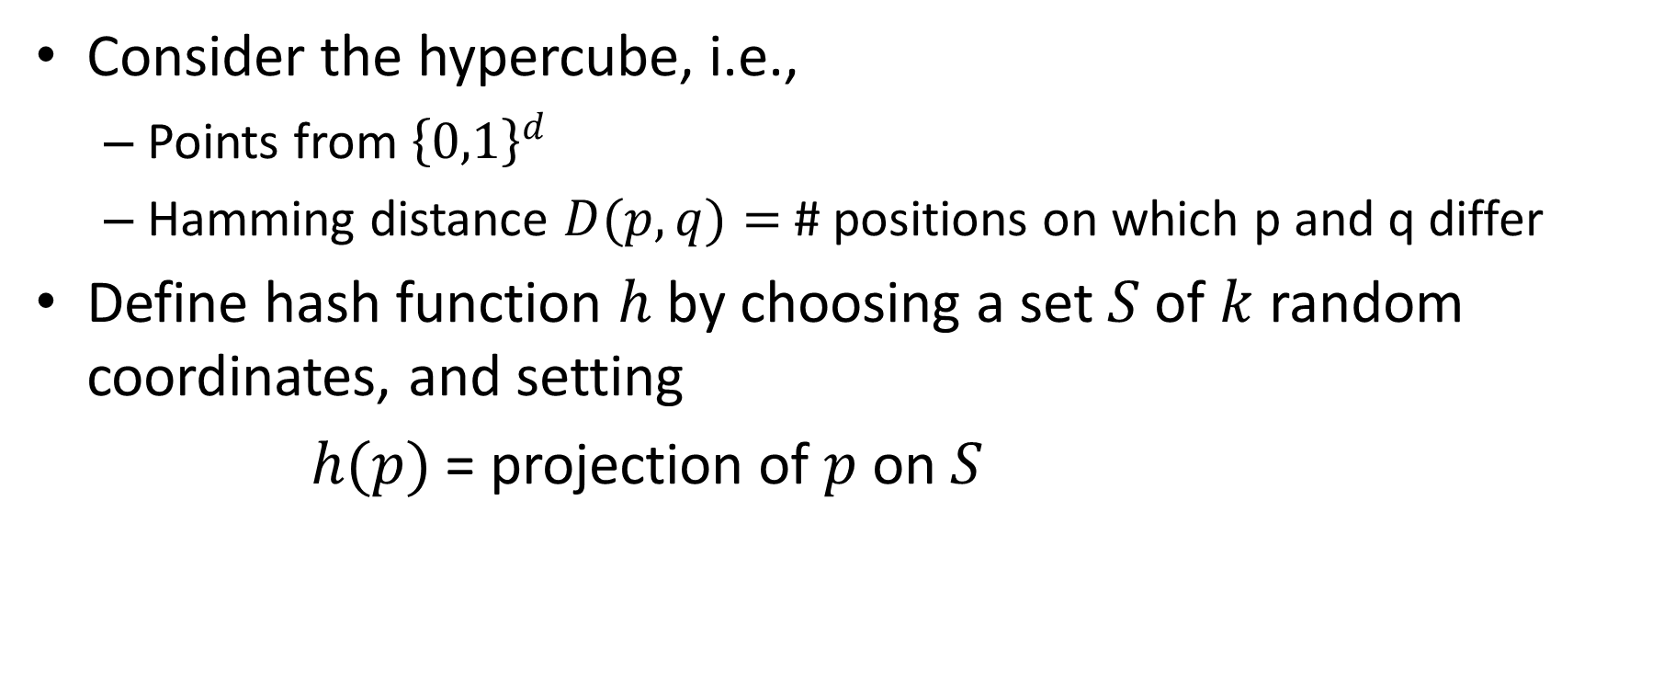
Do such functions exist ?
Consider the hypercube, i.e.,
Points from ${\left\{0,1\right\}}^{d}$
Hamming distance $D(p,q)=$# positions on which p and q differ
Define hash function $h$ by choosing a set $S$of $k$ random coordinates, and setting
$h(p)$ = projection of $p$on $S$

Slide 16
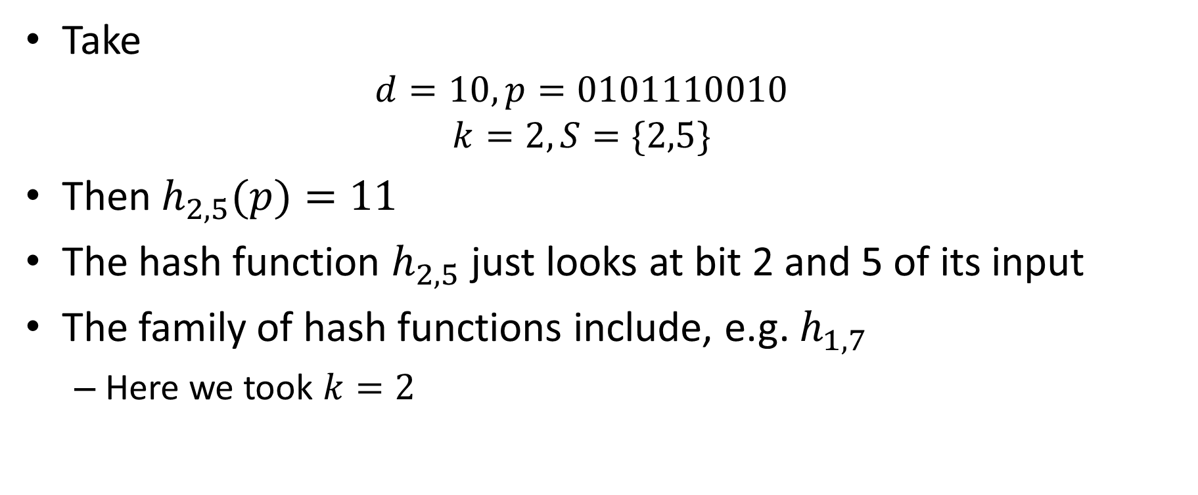
Example
Take
$$d=10, p=0101110010$$
$$k=2, S=\{2,5\}$$
Then $h_{2,5}(p)=11$
The hash function $h_{2,5}$ just looks at bit 2 and 5 of its input
The family of hash functions include, e.g. $h_{1,7}$
Here we took $k=2$

Slide 17

These hash functions are locality-sensitive
$$P⁡[h(p)=h(q)]=(1−\frac{D\left(p,q\right)}{d})k$$
We can vary the probability by changing k
P
k=1
P
k=2
distance
distance

Slide 18
Random Projections + Binning
Nearby points will often fall in same bin
Faraway points will rarely fall in same bin

Slide 19
Other important LSH families
We looked at Hamming distance via random subset projection
Angle similarity via projection onto random vector

Slide 20
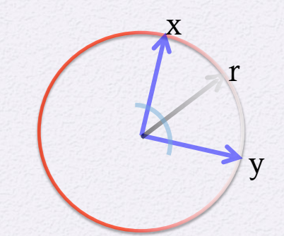
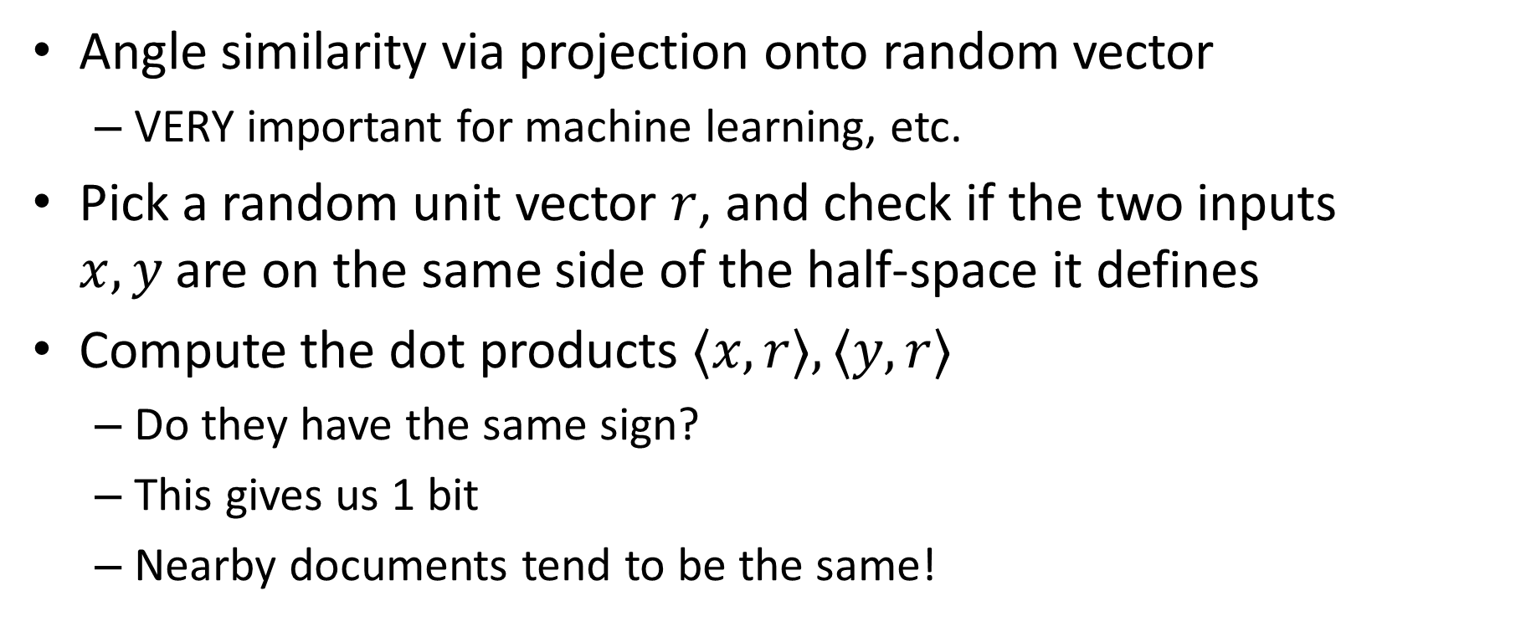
Angle similarity via SimHash
Angle similarity via projection onto random vector
VERY important for machine learning, etc.
Pick a random unit vector $r$, and check if the two inputs $x,y$are on the same side of the half-space it defines
Compute the dot products $〈x,r〉, 〈y,r〉$
Do they have the same sign?
This gives us 1 bit
Nearby documents tend to be the same!

